Slide 1
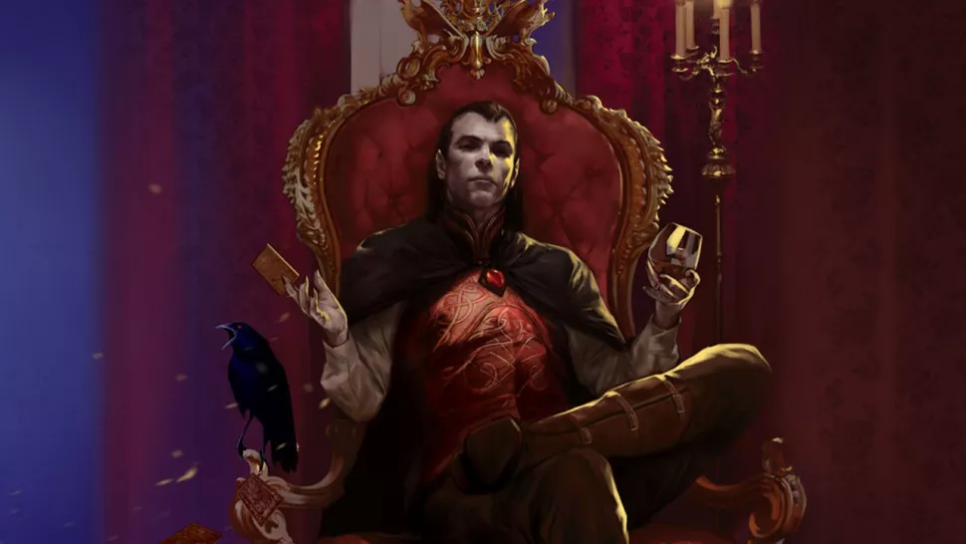
Final Project – Strahd battle
Kat Berton

Slide 2
What is it?
My project is a text based, turn based combat experience – single fight.
It closely emulates how you play Dungeons and Dragons:
Hit points (HP)
Attack rolls and armor class (AC)
Damage rolls
Player has their choice of “class”, fighter or caster, and their choice of “action”, attack or special.
If you reduce Strahd’s HP to 0, you win. If he reduces yours to 0, you lose.
Strahd is the vampire supervillain in the Dungeons and Dragons adventure named The Curse of Strahd (2016/1983).

Slide 3
What were some challenges?
Coming up with the idea in the first place.
Solutions: took a cue from real life and from the Mars Adventure labs we did.
Mental blocks around the conditional logic in the while loop of when the fight ends, i.e. when either Strahd or Player’s HP is equal to or less than 0.
Solutions: sleep! Also, talk through it in words, and then in more detailed words.
“Game ends when either Strahd or Player is reduced to 0 HP” becomes “game continues while both Strahd’s HP is greater than 0 and player’s HP is greater than 0.”
Taking the final step to tidy up the main action of the game into functions.
Solutions: I still haven’t come up with one yet. It works the way I want it to, but looks quite messy still.
TO DO LIST: Fix this by studying up more on how to update global variables in a tidy way outside of functions while still using functions to avoid repeating code.

Slide 4
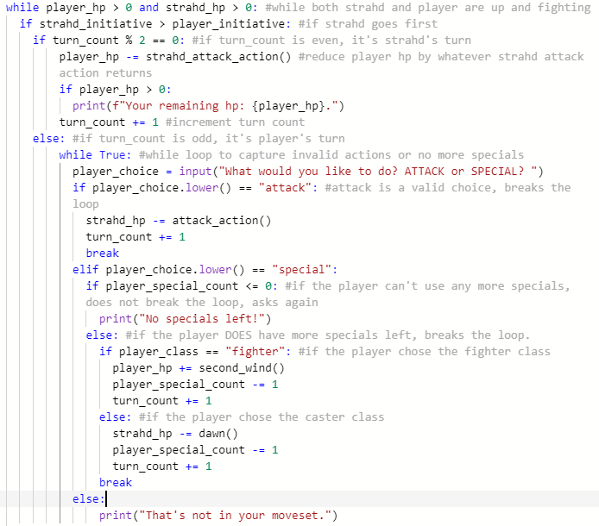
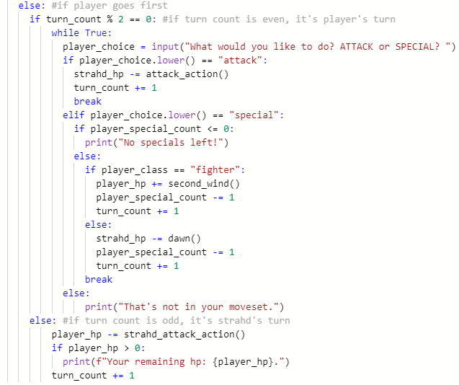

Slide 5
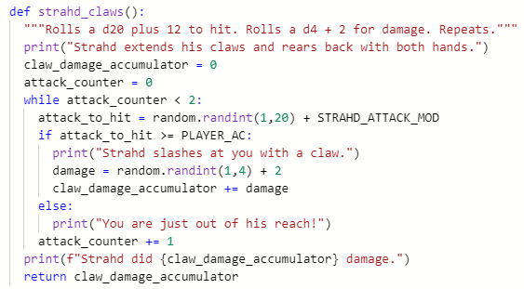
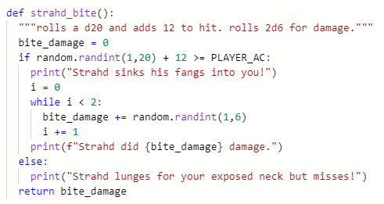
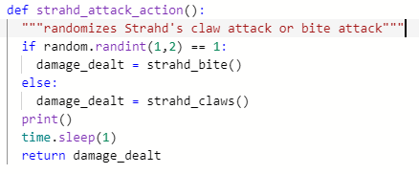
What was surprisingly easy?
Breaking a greater action into smaller functions.
Example:
Define strahd_bite(), with a roll to hit, and returns damage
Define strahd_claw(), with two rolls to hit, and accumulates and returns damage
Define strahd_attack_action(), which randomizes calling strahd_bite() or strahd_claw()
Adding blank lines and pauses to the console for readability

Slide 6
To do list
Tidy up the turn alternator section of the code into functions
Make Strahd’s closing monologue contingent upon his last move instead of randomized
Change player “class” option properties into a dictionary instead of variables
Add another “class” option for the player
Add a non-player character (NPC) ally

